Slide 1
LOAN REPAYMENT FORECASTING
Group Members:
Janvi Umesh Mirchandani
Le Hai Phu
Yash Dugar
Notes:
Main title: 40 pt. Arial
Presenter Name: 16 pt. Arial
Presenters Title: 16 pt. Arial Italic

Slide 2



TEAM INTRODUCTION
INTRODUCTION
Janvi Mirchandani
B.Eng Computer Science Birla Institute of Technology & Science
Le Hai Phu
B.A. International Business Econ Foreign Studies University Masters Supply Chain Mgmt MIT
Yash Dugar
B.Tech Automotive Engineering Delhi Technological University

Slide 3

AGENDA
AGENDA
Problem Statement
Overall Approach
Data Processing
EDA
Models
Key Takeaways

Slide 4



With this project, we plan to answer the following questions:
PROBLEM
STATEMENT
OVERALL
APPROACH
DATA
PROCESSING
AGENDA
EDA
MODELS
KEY
TAKEAWAYS
Predicting whether the loan will be fully paid or not?
What are the risks are associated for the borrower?
Is it wise to invest in the borrower given the risk?
With the datasets, we plan to predict if a borrower will be able to pay the loan (based on different features) or not, thus evaluating the chance of loan re-payment for the investors
Understanding data features and their importance, thus helping better evaluate the risks involved with the loan
Evaluating the chance of loan repayment, and determining if it’s wise for the investors to provide the loan to the borrower
With our model, we aim to implement necessary data analyses & improve the overall score of our model

Slide 5





Our dataset consisted of ~10K rows & 14 features, among which “Not Fully Paid” is our target variable
PROBLEM
STATEMENT
OVERALL
APPROACH
DATA
PROCESSING
DATA ANALYSES & DATA PROCESSING
EDA
MODELS
KEY
TAKEAWAYS
The binary dependent variable “Not Fully Paid” indicates that the loan was not paid back in full.
Feature Scaling to bring the entire dataset to a similar scale, thus improving our overall model
01
03
05
We had several NA values in our data, and we replaced them with mean values, wherever possible
02
One hot encoding of features, that are non numerical and thus can’t be directly used in our data analyses
04
EDA helped us understand our data’s distribution, and doing necessary transformation for certain features, as needed
We will go in detail of the above summary, in subsequent slides

Slide 6

Before we start modelling our data, we need to do some basic data processing steps
PROBLEM
STATEMENT
OVERALL
APPROACH
DATA
PROCESSING
DATA ANALYSES & DATA PROCESSING
EDA
MODELS
KEY
TAKEAWAYS
One Hot Encoding
Feature Scaling
Train-Test Split
Many machine learning algorithms cannot operate on label data directly. They require all input variables and output variables to be numeric.
One hot encoding is a process by which categorical variables are converted into a form that could be provided to ML algorithms.
It creates column for all the different categorical value: 0-represents non- existent, while 1 indicates existent.
Feature scaling in machine learning is one of the most critical steps during the pre-processing of data before creating a machine learning model.
Scaling can make a difference between a weak machine learning model and a better one.
The most common techniques of feature scaling are Normalization and Standardization
Train test split is a model validation process that allows you to simulate how your model would perform with new data.
Split the data set into two pieces — a training set and a testing set. This consists of random sampling without replacement about 80 percent of the rows (you can vary this) and putting them into your training set. The remaining 20 percent is put into your test set.
We also replaced/removed any NA values from our data, thus making the dataset ready for any analyses and implementing machine learning

Slide 7
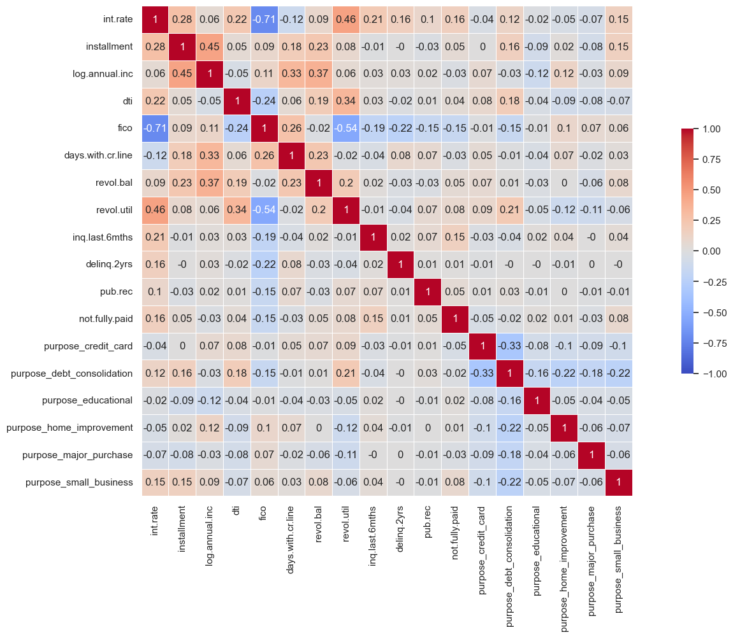
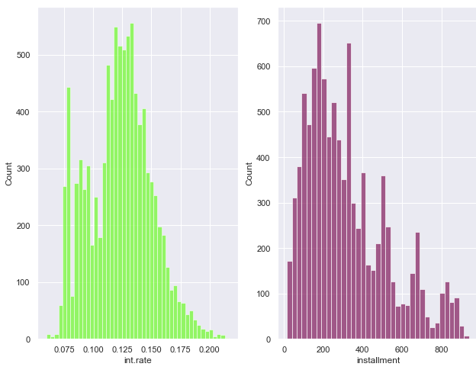
As the next step, we examined several data summaries & visualizations to better understand our entire dataset
PROBLEM
STATEMENT
OVERALL
APPROACH
DATA
PROCESSING
DATA ANALYSES & DATA PROCESSING
EDA
MODELS
KEY
TAKEAWAYS
Correlation Plot
Distribution of different features
Breakdown of Loans repayment
Most of the features were normally distributed (others were transformed) before performing modelling or any other analyses
~16% of the loans (in our dataset) were not paid in full, by the borrower
Correlation between different features, to determine any relationship among the various features

Slide 8
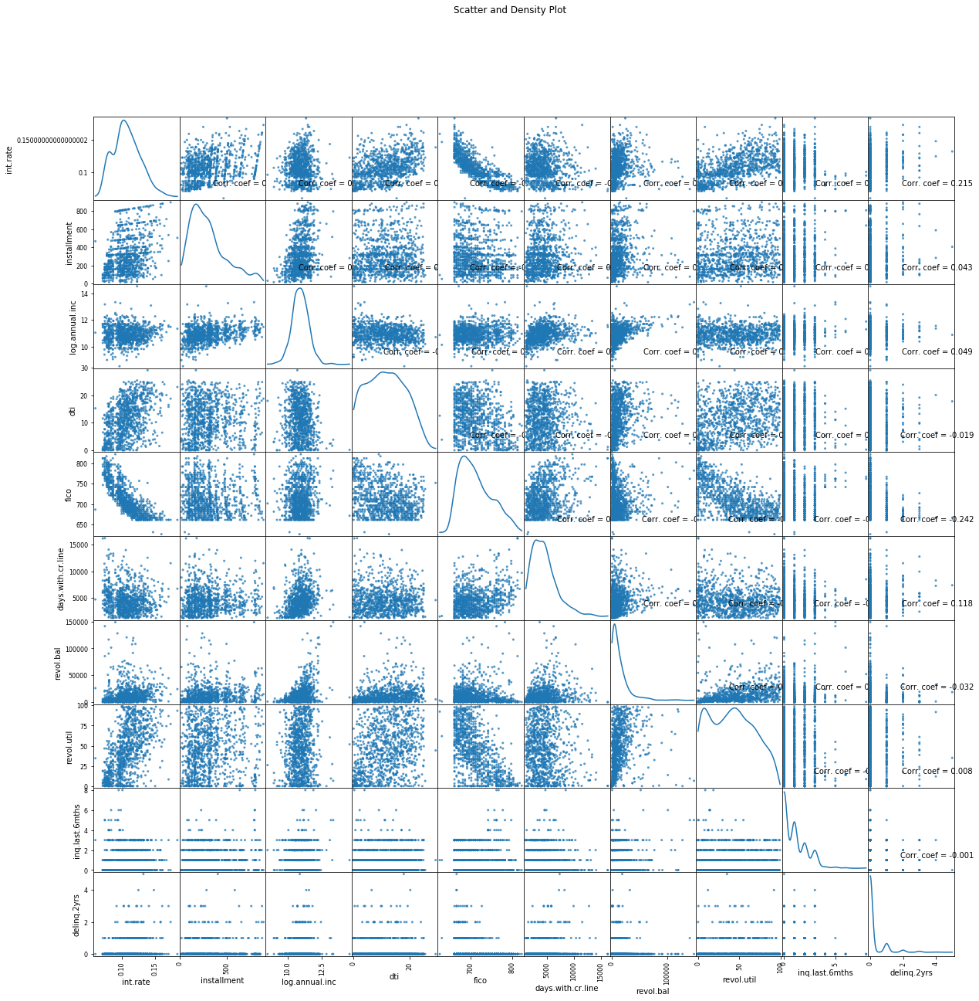
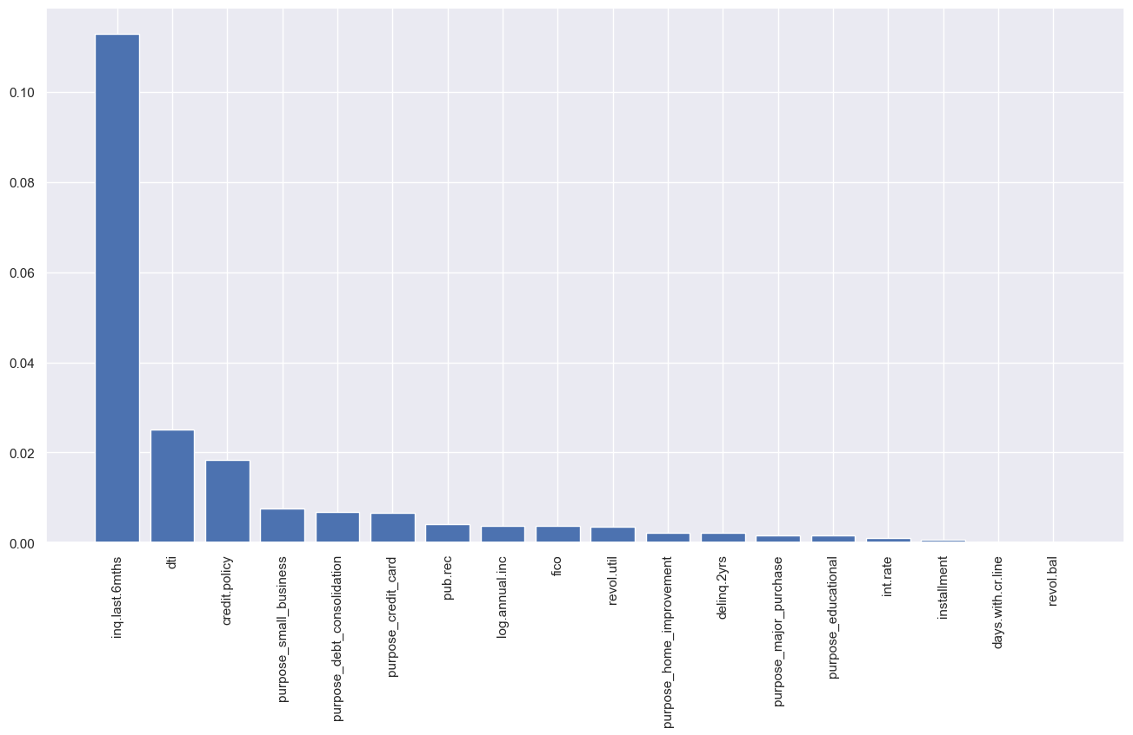
Other EDA exercise included, looking at feature importance and plotting a scatter/density plot across the various features
PROBLEM
STATEMENT
OVERALL
APPROACH
DATA
PROCESSING
DATA ANALYSES & DATA PROCESSING
EDA
MODELS
KEY
TAKEAWAYS

Slide 9
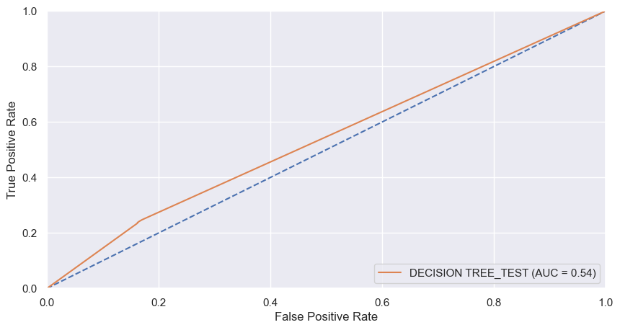
DECISION TREE (Accuracy-74% ; NPV¹-24%)
PROBLEM
STATEMENT
OVERALL
APPROACH
DATA
PROCESSING
MACHINE LEARNING MODELS
EDA
MODELS
KEY
TAKEAWAYS
Confusion Matrix
1344
265
Paid Fully
TRUE LABEL
Decision Tree only gives an approximate accuracy of ~74% , but only predict ~24% of loan non repayors
233
74
Not
Paid Fully
Paid Fully
Not
Paid Fully
PREDICTED LABEL
A high accuracy but very low chances of predicting a loan non repayor suggests that “Decision Tree” is not the right model for our dataset
¹NPV- Negative Predictive Value

Slide 10
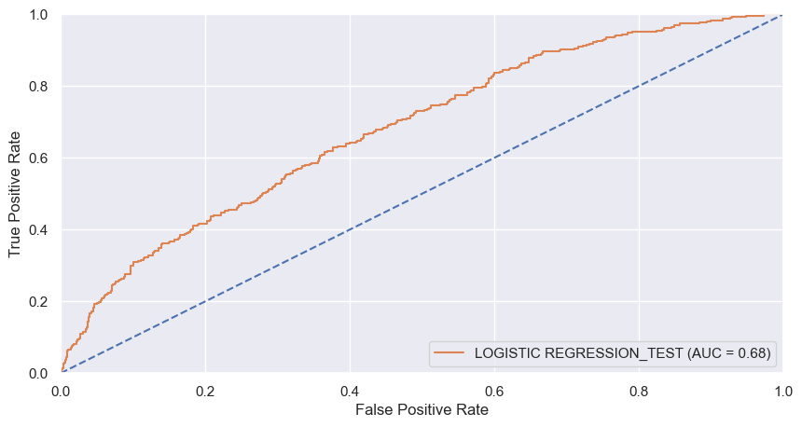
Logistic Regression (Accuracy-62% ; NPV¹-62%)
PROBLEM
STATEMENT
OVERALL
APPROACH
DATA
PROCESSING
MACHINE LEARNING MODELS
EDA
MODELS
KEY
TAKEAWAYS
Confusion Matrix
1004
605
Paid Fully
TRUE LABEL
High % of the “Not Paid Fully” payors are predicted (62%), with the logistic regression model
117
190
Not
Paid Fully
Paid Fully
Not
Paid Fully
PREDICTED LABEL
Logistic regression performs well when we look for potential borrowers, who might not re-pay the complete loan, but the accuracy of the models limit to 62%
¹NPV- Negative Predictive Value

Slide 11
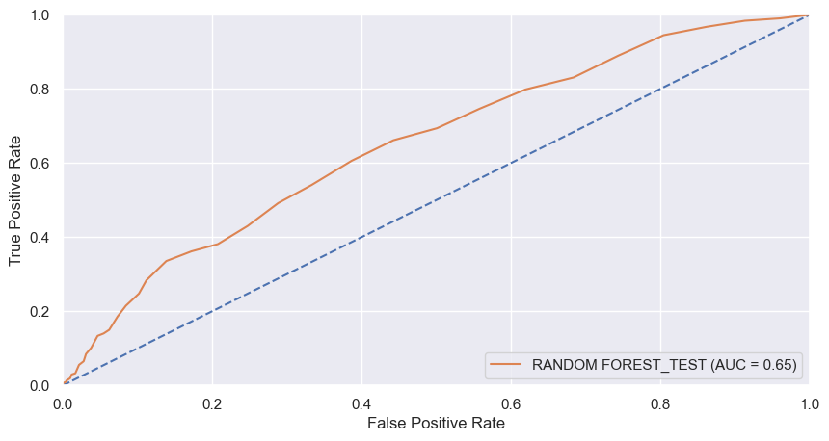
Random Forest (Accuracy-65% ; NPV¹-54%)
PROBLEM
STATEMENT
OVERALL
APPROACH
DATA
PROCESSING
MACHINE LEARNING MODELS
EDA
MODELS
KEY
TAKEAWAYS
Confusion Matrix
1073
536
Paid Fully
TRUE LABEL
High Accuracy of 65%, as well as ability to predict ~54% of the loan non repayors
141
166
Not
Paid Fully
Paid Fully
Not
Paid Fully
PREDICTED LABEL
Random forest seems to work well with our model. It can predict almost 55% of the non loan repayors, and still maintains a high accuracy of 65%
¹NPV- Negative Predictive Value

Slide 12
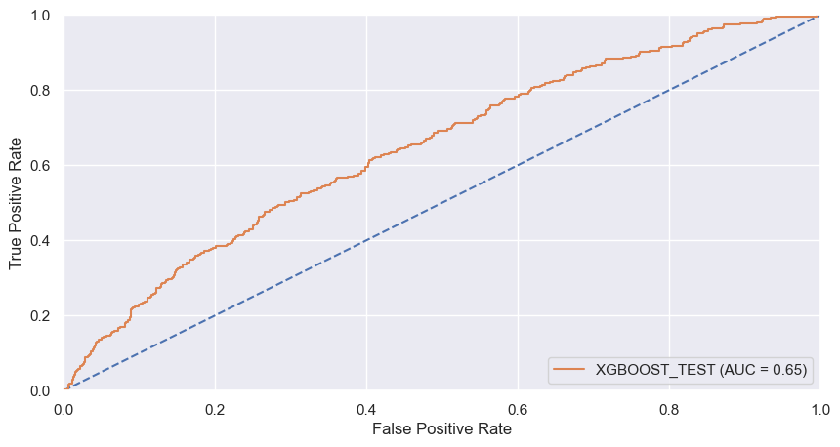
XGBoost (Accuracy-60% ; NPV¹-60%)
PROBLEM
STATEMENT
OVERALL
APPROACH
DATA
PROCESSING
MACHINE LEARNING MODELS
EDA
MODELS
KEY
TAKEAWAYS
Confusion Matrix
962
647
Paid Fully
NPV Value with XGBoost is same as overall accuracy of ~60%
TRUE LABEL
124
183
Not
Paid Fully
Paid Fully
Not
Paid Fully
PREDICTED LABEL
With the right parameter tuning, XGBoost gives equal performance in terms of both accuracy and NPV
¹NPV- Negative Predictive Value

Slide 13
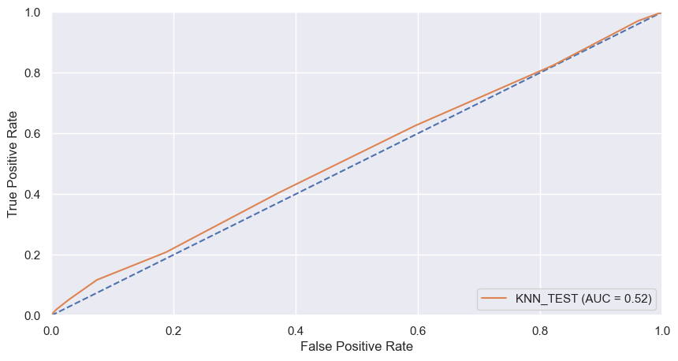
KNN (Accuracy-60% ; NPV¹-40%)
PROBLEM
STATEMENT
OVERALL
APPROACH
DATA
PROCESSING
MACHINE LEARNING MODELS
EDA
MODELS
KEY
TAKEAWAYS
Confusion Matrix
1011
598
Paid Fully
TRUE LABEL
High chances of predicting a loan defaulter, but a very low overall accuracy of ~61%
183
124
Not
Paid Fully
Paid Fully
Not
Paid Fully
PREDICTED LABEL
KNN has a decent accuracy but very low NPV, suggesting it is also not the best model for our dataset
¹NPV- Negative Predictive Value

Slide 14
3 of the 5 Models perform very similar, and give optimum results for our dataset
PROBLEM
STATEMENT
OVERALL
APPROACH
DATA
PROCESSING
RESULTS
EDA
MODELS
KEY
TAKEAWAYS
Increasing Accuracy of the model
DECISION TREE
(Accuracy-74% ; NPV-24%)
Average
Performance Model
High
Performance Model
1
Increasing NPV of the model
1
2
Logistic Regression (Accuracy-62% ; NPV-62%)
2
4
3
3
Random Forest
(Accuracy-65% ; NPV-54%)
Low
Performance Model
Average
Performance Model
4
XGBoost
(Accuracy-60% ; NPV-60%)
5
5
KNN
(Accuracy-60% ; NPV-40%)
Optimum Models, based on the overall results
“Logistic Regression” is the best performing model for our dataset, giving the best results compared to other models

Slide 15




Enhancement and Conclusion
PROBLEM
STATEMENT
OVERALL
APPROACH
DATA
PROCESSING
RESULTS
EDA
MODELS
KEY
TAKEAWAYS
Methodology
Advance Modelling Techniques
01
02
03
04
In this study, the dataset was cleaned first, and the exploratory data analysis and feature engineering were performed. Then we propose 5 machine learning models to predict if the applicant could repay the loan, which are Random Forest, Logistic Regression, Decision Tree, XGBoost, and K-Nearest Neighbors.
Neural network and other deep learning algorithm method might be more helpful and provide better results when predicting for the loan repayment status
More and more data…
Risk Prediction
If we would have a larger dataset, we would have more training samples. By which, it might help fix the low scoring of our models and make our analysis more valid
As we expected, borrowers with higher annual income and higher FICO scores are more likely to repay the loan fully; In addition, borrowers with lower interest rates and smallerinstallments are more likely to pay the loan fully
Through this study, it is noticed that the model was found which best fits the dataset with highest accuracy is the random forest model, and the model with balance Accuracy & NPV score is Logistic Regression
¹NPV- Negative Predictive Value

Slide 16

Thank You. Any Questions?

